Slide 1
Health care Analytics
By Khaja Moiezuddin Mohammed

Slide 2
Introduction
The U.S. spends more on health care as a share of the economy. It spends nearly twice as much as the average developed country and yet has the lowest life expectancy and highest suicide rates among the 11 nations.
Poor management of health care resources is one of the leading factors of increased death rates and increased expenses among the patients in US.
Recent Covid-19 Pandemic has raised alarms over one of the most overlooked area to focus: Healthcare Management. While healthcare management has various use cases for using data science, patient length of stay is one critical parameter to observe and predict if one wants to improve the efficiency of the healthcare management in a hospital.

Slide 3
Objective
Health analytics (with the given data, look for the trends like what kind of cases are registered daily in a particular area)
Here we have dependent variables like Age, severity of illness. These are the factors responsible for higher staying period in the hospital. if we look for correlation between the major factors and perform hypothesis then we can achieve desired objectives.
Creating different visualization to understand the trend.
Applying feature engineering methods and to build a regression model to predict the duration of stay of a patient.
The main objective of this project is to build a model which can predict the length of stay of a patient, so that the hospital can manage and allocate its resources accordingly, this can help to save many lives.

Slide 4
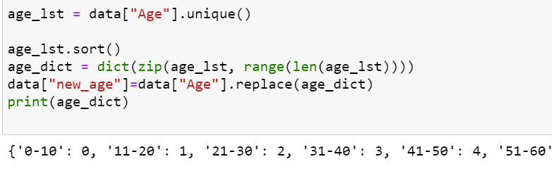
Data cleaning
The first and basic step involved is data cleaning
Here I have replaced all the null values with appropriate values
I have replaced all the values which are of object type into integer types.

Slide 5
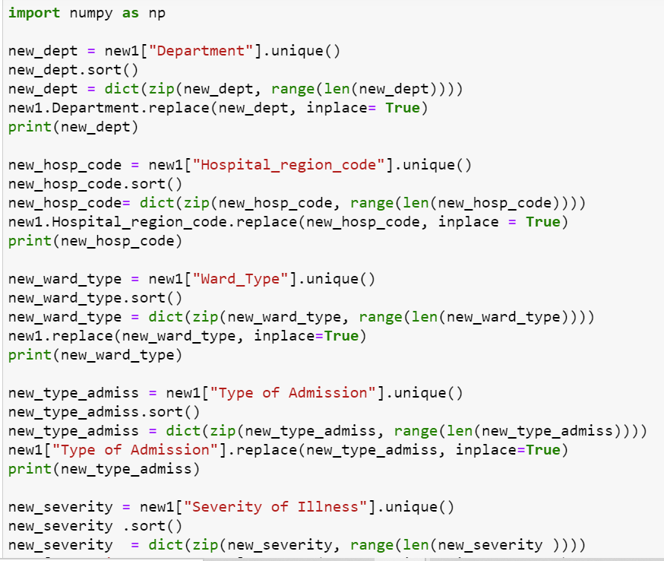
Replacing all the object type values with int values

Slide 6
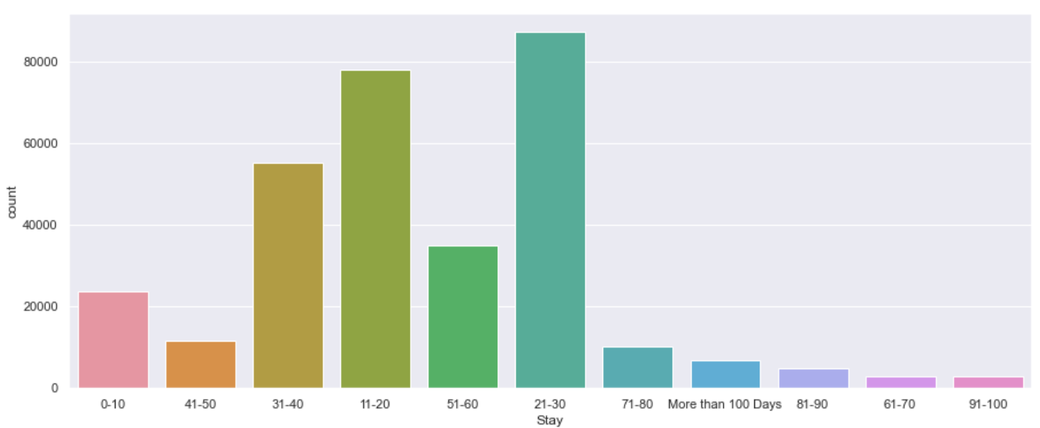
Visualizations
This bar graph shows the count of how many stayed for certain time

Slide 7
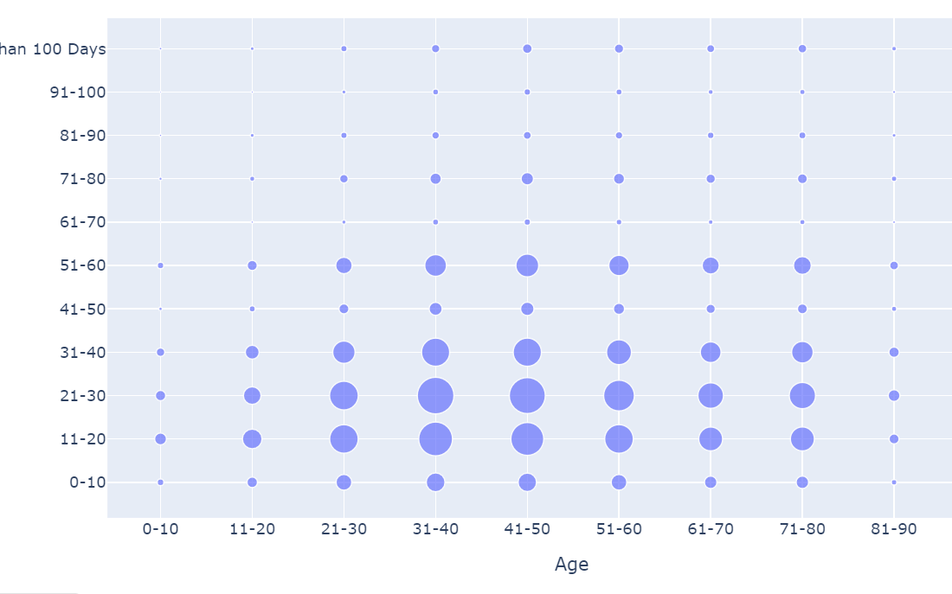
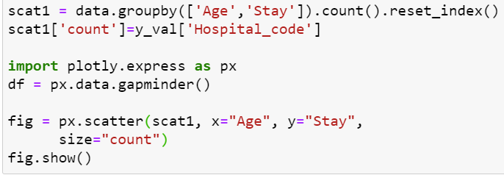

Slide 8
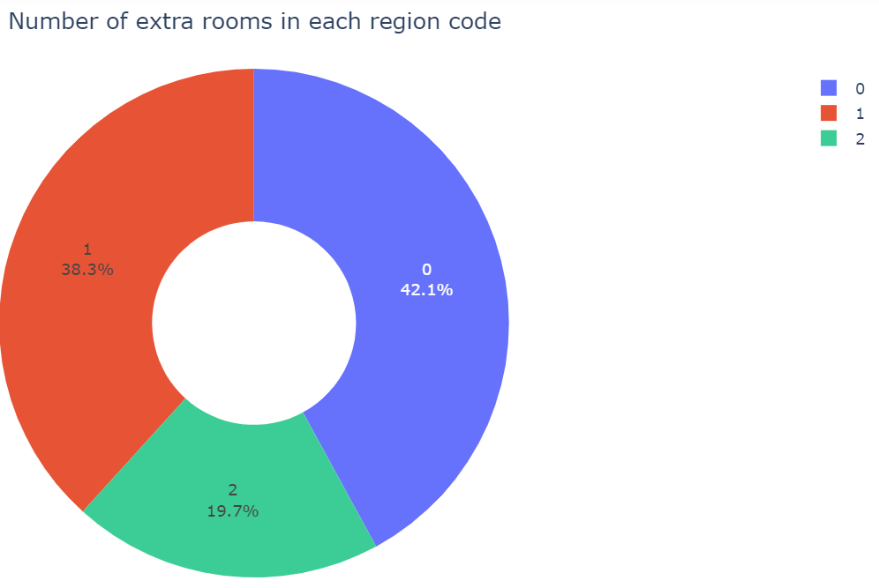
import plotly.express as px
extra_room=new1.groupby('Hospital_region_code')['Available Extra Rooms in Hospital'].sum().reset_index()
fig4=px.pie(extra_room,values='Available Extra Rooms in Hospital',names='Hospital_region_code',hole=0.4)
fig4.update_layout(title='Number of extra rooms in each region code',title_x=0.5)
fig4.update_traces(textinfo='percent+label')

Slide 9
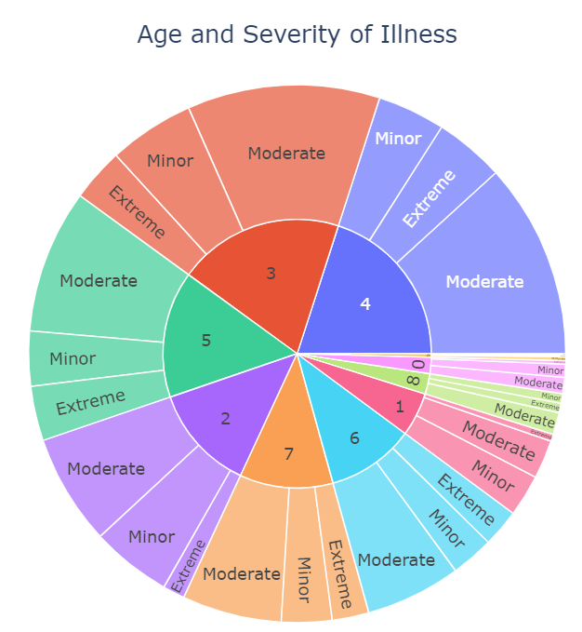
age_plot=px.sunburst(data, path=['Age','Severity of Illness'])
age_plot.update_layout(title='Age and Severity of Illness',title_x=0.5)
age_plot.show()

Slide 10
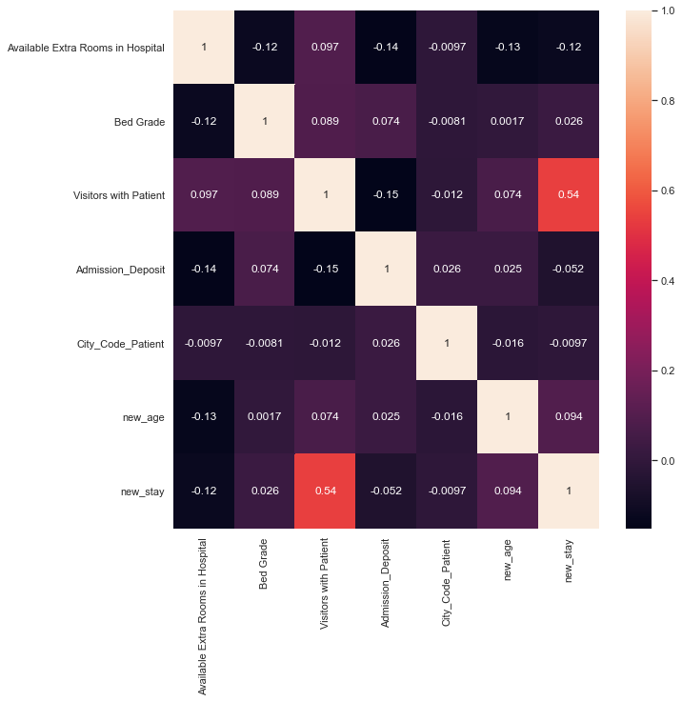
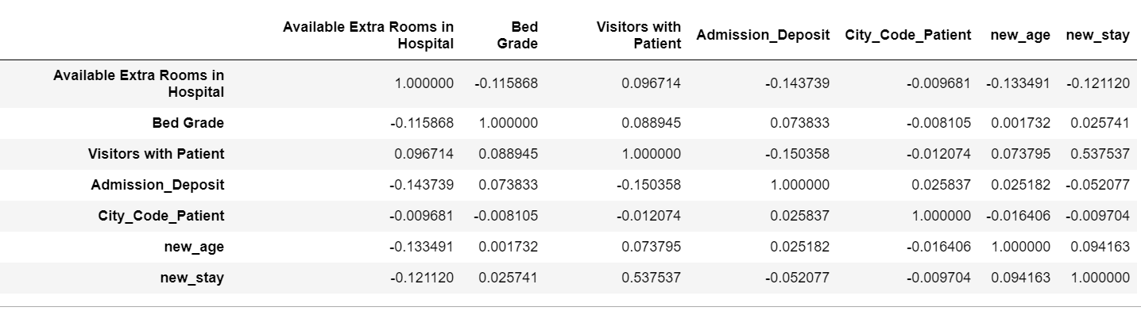

Slide 11
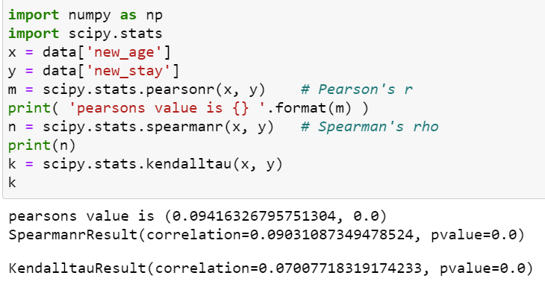
Kendall’s Tau is a non-parametric measure of relationships between columns of ranked data. The Tau correlation coefficient returns a value of 0 to 1, where:
0 is no relationship,
1 is a perfect relationship.
spearman's Rho is a non-parametric test used to measure the strength of association between two variables, where the value r = 1 means a perfect positive correlation and the value r = -1 means a perfect negataive correlation. So, for example, you could use this test to find out whether people's height and shoe size are correlated (they will be - the taller people are, the bigger their feet are likely to be).

Slide 12
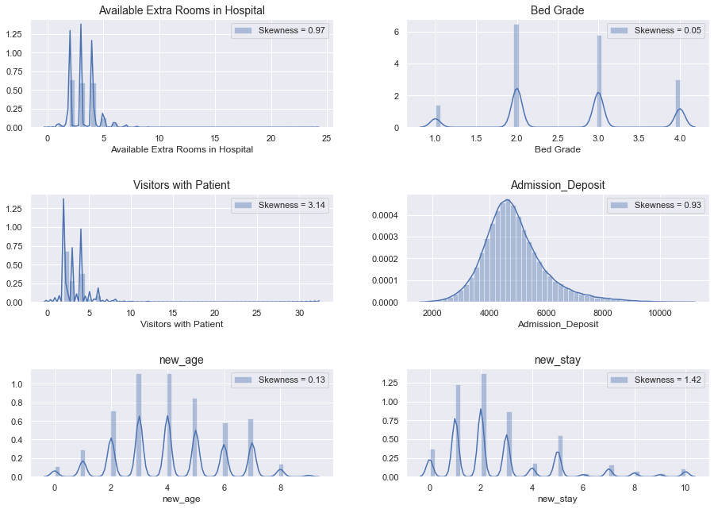

Slide 13
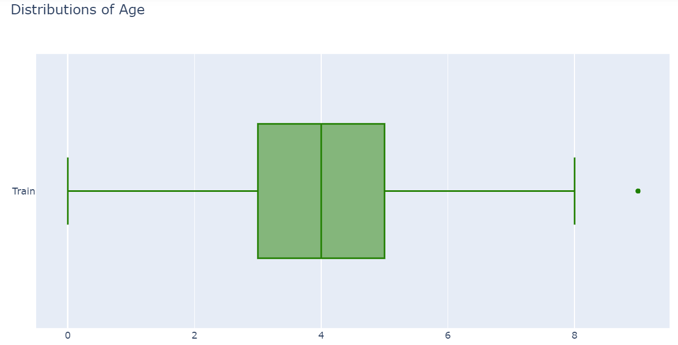
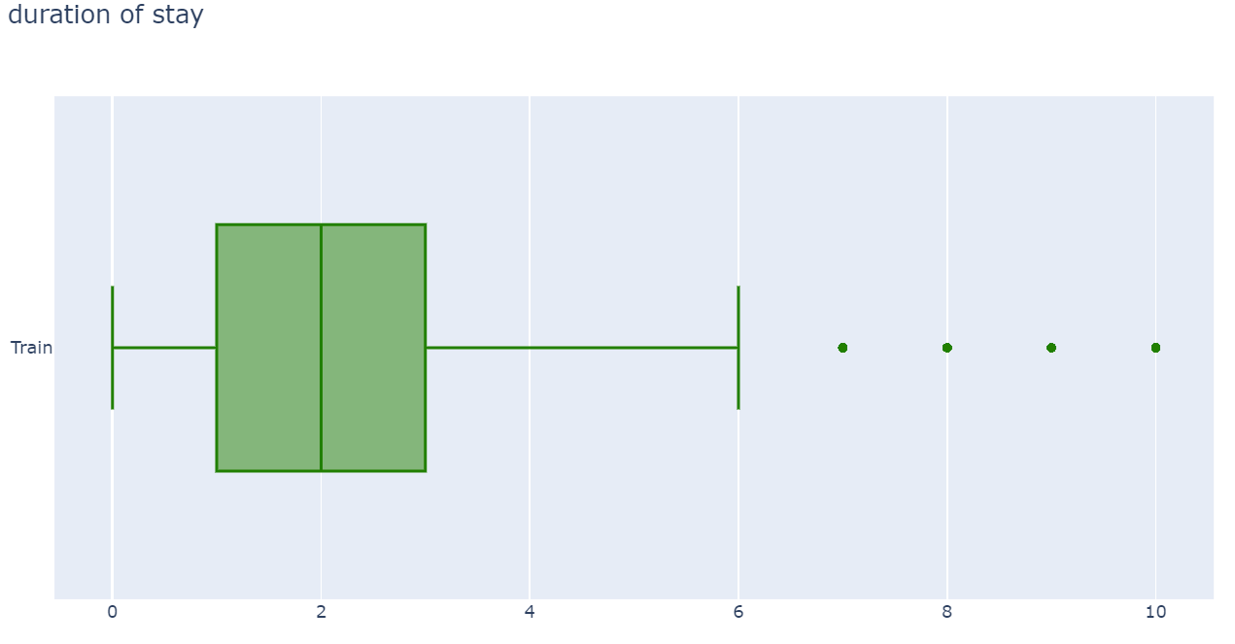
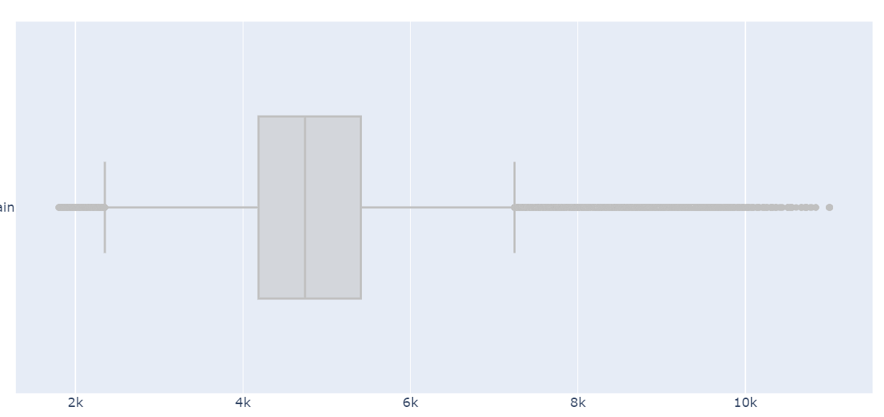

Slide 14
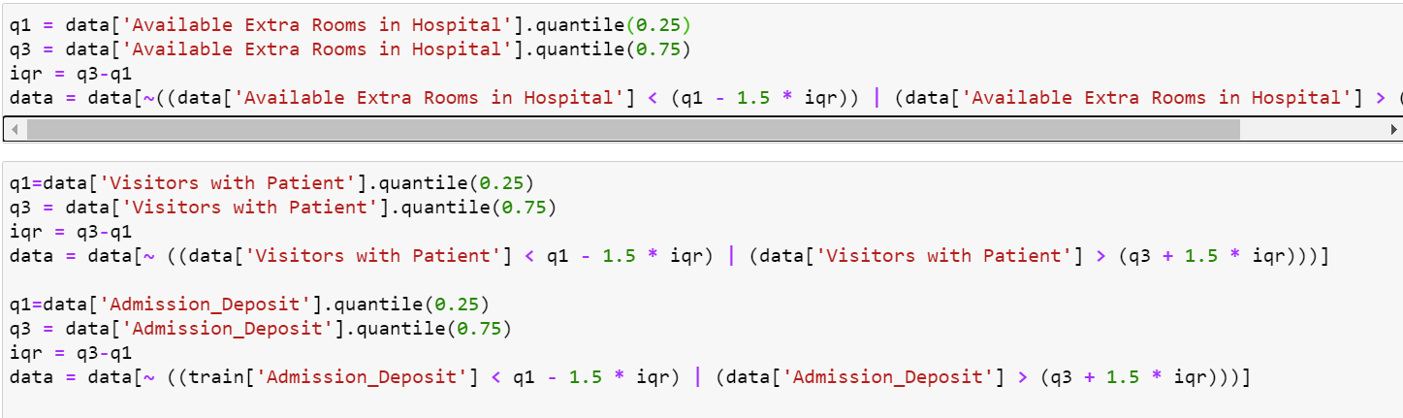
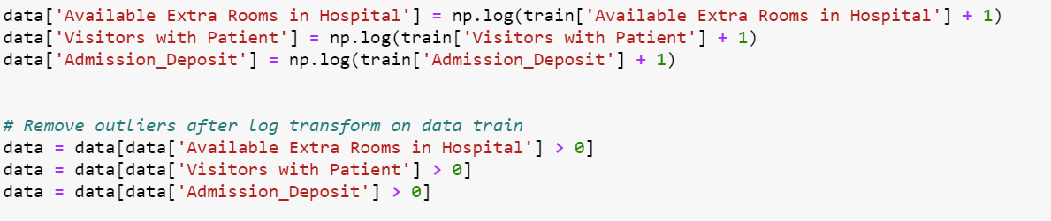

Slide 15
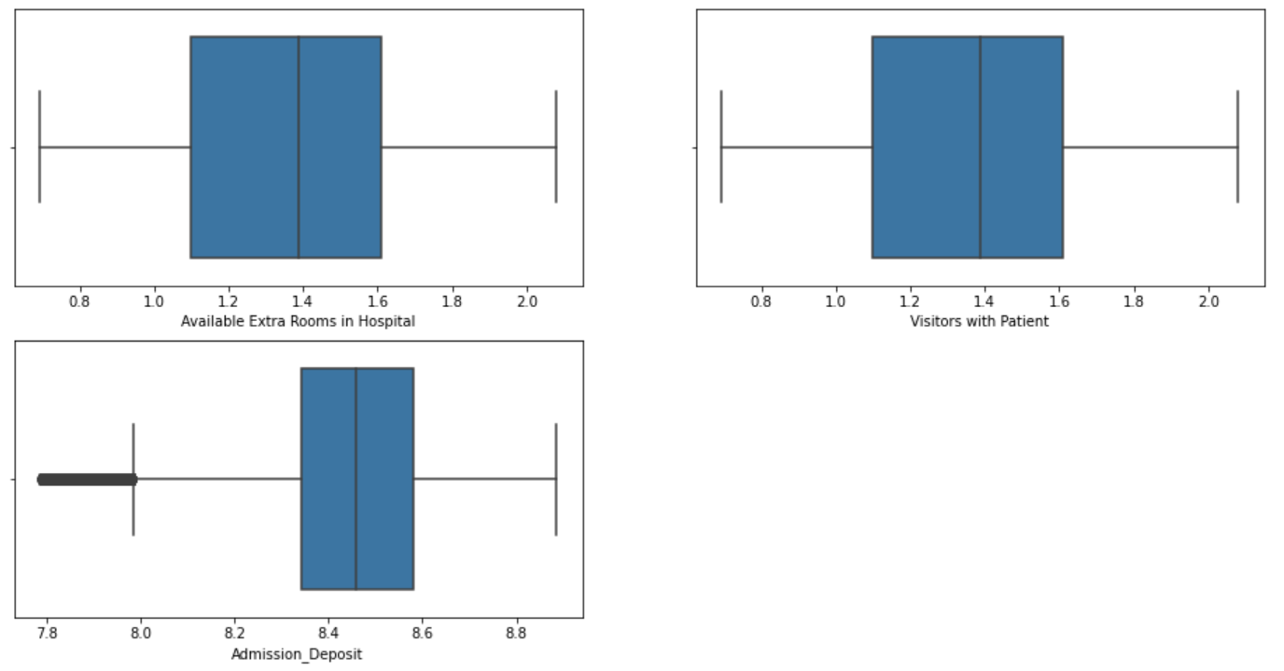

Slide 16
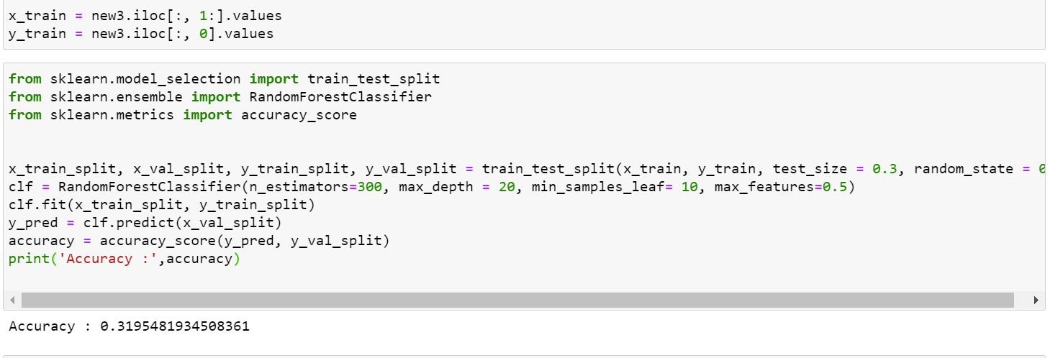
For the random forest model the accuracy obtained was 31.9 % ,
This is before making any possible changes and before removing outliers

Slide 17
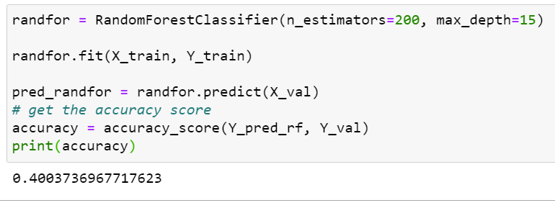
Here the accuracy has been increased due to making necessary changes

Slide 18
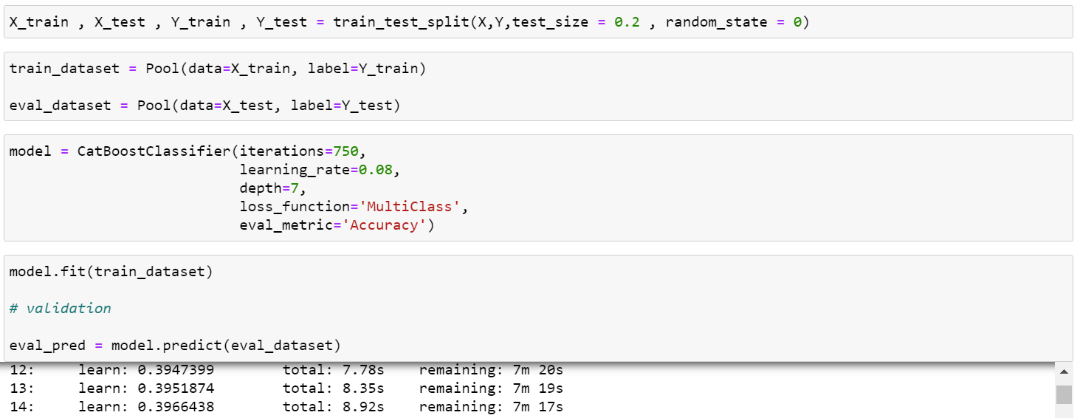
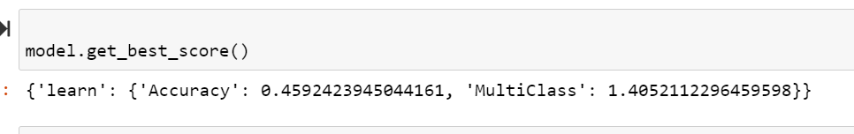
CatBoost Model

Slide 19
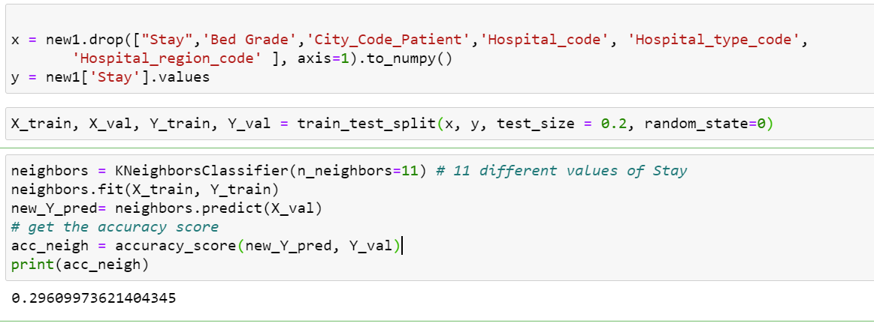
KNN Model

Slide 20
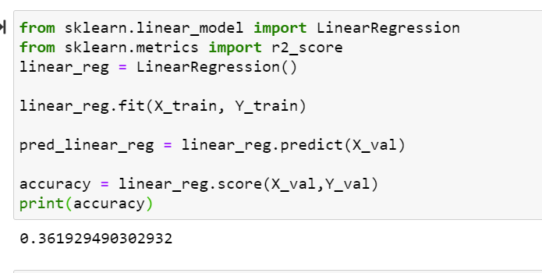
Linear Regression

Slide 21
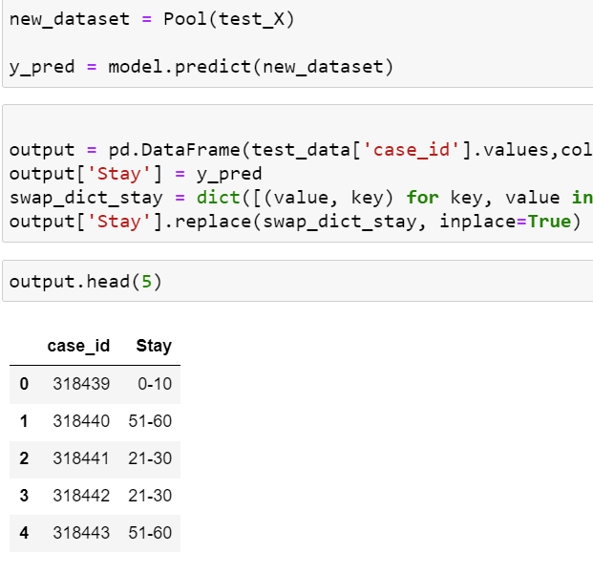
Prediction
As the catboost model gave the highest accuracy, I have used that model for prediction of the data.

